Slide 1
OpenCDS: an Open-Source,
Standards-Based, Service-Oriented Framework for Scalable CDS
SOA in Healthcare 2011 Conference
July 13, 2011
Kensaku Kawamoto, MD, PhD
Founder, OpenCDS (www.opencds.org)
Co-Chair, HL7 Clinical Decision Support Work Group
Assistant Professor, Duke Center for Health Informatics
8/11 - Assistant Prof., Dept. of Biomedical Informatics, Univ. of Utah
8/11 - Director, Knowledge Management & Mobilization, Univ. of Utah
Notes:
SCT 14May

Slide 2
Presentation Overview
Background
  Clinical decision support (CDS) - definition, examples, evidence of effectiveness
Problem
  Need for scalable CDS
Potential Solution
  Standards-based, open-source CDS services
OpenCDS
Discussion
Notes:
SCT 14May

Slide 3
Presentation Overview
Background
  Clinical decision support (CDS) - definition, examples, evidence of effectiveness
Problem
  Need for scalable CDS
Potential Solution
  Standards-based, open-source CDS services
OpenCDS
Discussion
Notes:
SCT 14May

Slide 4
Clinical Decision Support (CDS)
The act of providing clinicians, patients and other healthcare stakeholders with pertinent knowledge and/or person-specific information, intelligently filtered or presented at appropriate times, to enhance health and health care (Osheroff, J Am Med Inform Assoc, 2007)
Notes:
SCT 14May

Slide 5
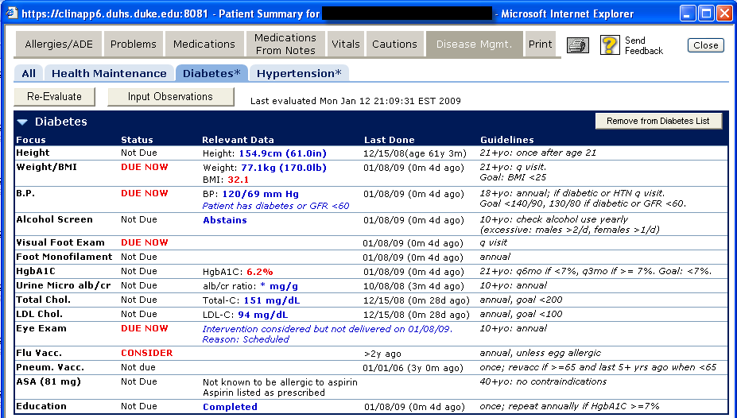
Example Disease Management Reminders
Source: Duke University Health System. Lobach DF, Kawamoto K, et al. Medinfo. 2007;861-5.

Slide 6
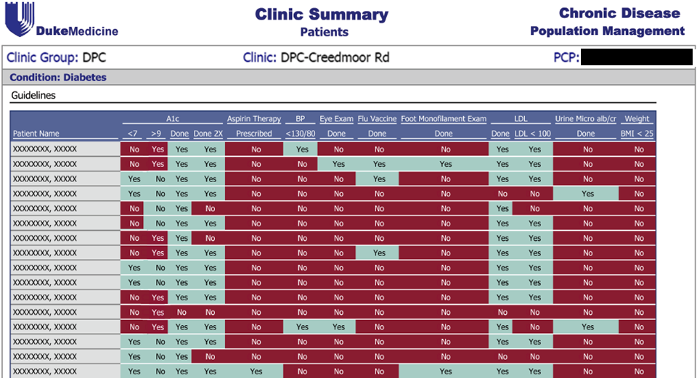
Example Care Quality Reporting
Source: Duke University Health System.

Slide 7
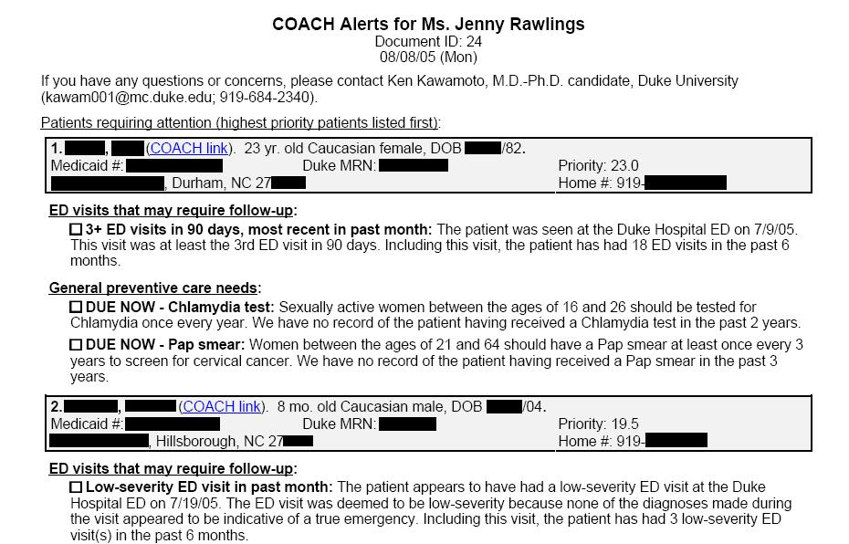
Example Care Manager Alert
Source: NC Medicaid. Lobach DF, Kawamoto K, et al. AMIA Annu Symp Proc. 2007;473-7.

Slide 8
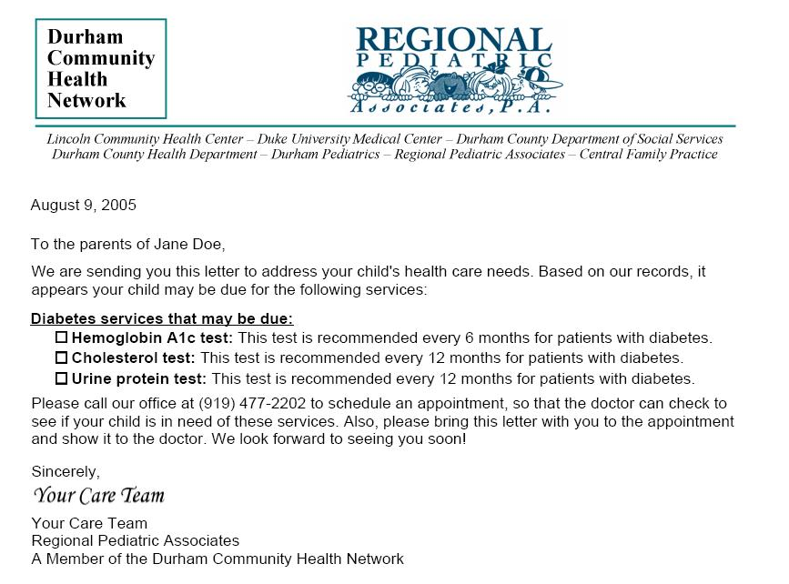
Example Patient Reminder Letter
Source: NC Medicaid. Lobach DF, Kawamoto K, et al. Proc / AMIA Annual Symp. 2007;473-7.

Slide 9
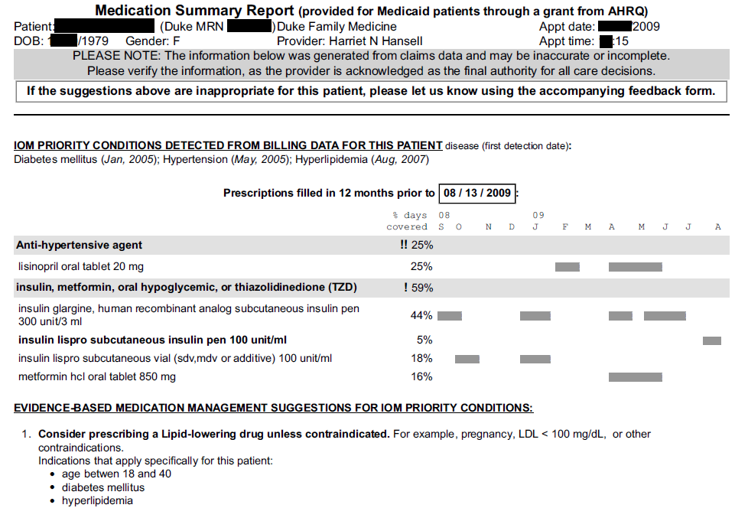
Example Medication Management Report
Source: Del Fiol G, Kawamoto K, et al. AMIA Proceedings, 2010.

Slide 10
Evidence of CDS Effectiveness
Evidence from systematic reviews
  Actionable, computer-generated CDS provided automatically at the point of care significantly improved care quality in >90% of RCTs (Kawamoto, BMJ, 2005)
  CDS generally more effective than other QI approaches – including CME, audit and feedback, EBM guideline creation & dissemination, & financial incentives
Examples of effectiveness
  86% reduction in serious medication errors at Brigham and Women’s Hospital (Bates, 1999)
  93.8% compliance with NCEP guidelines vs. 35.2% compliance in academic cardiology clinic (Stamos, 2001)
Notes:
SCT 14May

Slide 11
Presentation Overview
Background
  CDS - definition, examples, evidence of effectiveness
Problem
  Need for scalable CDS
Potential Solution
  Standards-based, open-source CDS services
OpenCDS
Discussion
Notes:
SCT 14May

Slide 12
The Problem
Despite demonstrated effectiveness, CDS is not widely available
The lack of CDS availability is due in part to the tight coupling of CDS capabilities with specific institutions and health IT systems
Notes:
SCT 14May

Slide 13
The Need
Application-independent CDS resources that can be efficiently leveraged by diverse healthcare systems and health IT settings to improve patient health
Notes:
SCT 14May

Slide 14
Presentation Overview
Background
  CDS - definition, examples, evidence of effectiveness
Problem
  Need for scalable clinical decision support (CDS)
Potential Solution
  Standards-based, open-source CDS services
OpenCDS
Discussion
Notes:
SCT 14May

Slide 15
Rationale for Open, Standards-Based CDS Services
Why CDS services?
  Encapsulates knowledge in highly reusable components
  Supports multiple knowledge representation approaches
  Validated by several groups
    SEBASTIAN
    DOD DDSS-KMR
    Partners ECRS / CDS Consortium
Why standards-based?
  To enable interoperability and scalability
Why open source?
  To foster adoption and collaboration
Notes:
SCT 14May

Slide 16
CDS Services – Architectural Overview
Standard Interface:
HL7/OMG Decision Support Service Standard
(http://hssp-dss.wikispaces.com)
Standard Data Models:
HL7 Virtual Medical Record (vMR) Standard
[ http://wiki.hl7. org/index.php?title= Virtual_Medical_Record_(vMR) ]
Institution A
Trigger
Queries for required pt
data
Patient Data Sources
Patient data,
knowledge modules to use
Client Decision Support Apps
Conclusions about patient
Decision Support Service
Institution B
Queries for required pt
data
Patient Data Sources
Client Decision Support Apps
Knowledge Modules
Notes:
SCT 14May

Slide 17
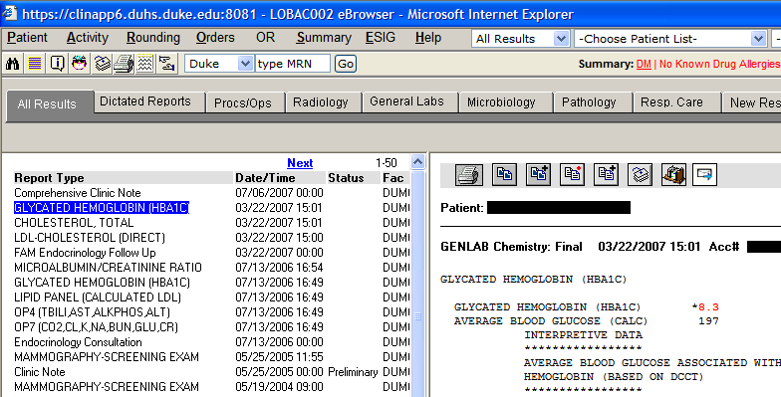
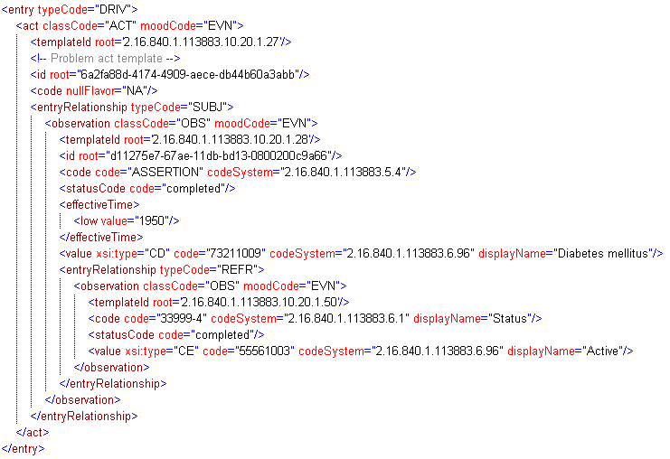
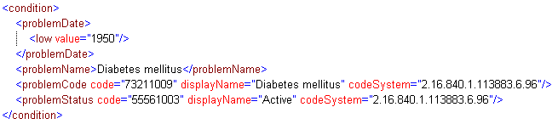
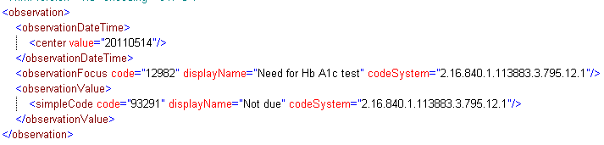
CDS Services – Example
Eval. Result
VMR
CCD
Pt data
Decision Support Service
Patient Data Sources
EHR System
Notes:
SCT 14May

Slide 18
Presentation Overview
Background
  CDS - definition, examples, evidence of effectiveness
Problem
  Need for scalable clinical decision support (CDS)
Potential Solution
  Standards-based, open-source CDS services
OpenCDS
Discussion
Notes:
SCT 14May

Slide 19
OpenCDS
Goal
  Facilitate widespread availability of advanced CDS capabilities through open-source, collaborative development of standards-based DSS infrastructure, tooling, and high-value services
Methods
  Contribute through Open Health Tools
  Leverage open-source JBoss Drools rules engine
  Use modular architecture, enable iterative refinement, support multiple knowledge represent. approaches
  Develop all components required to author, test, and operationally support standards-compliant DSSs

Slide 20
Current OpenCDS Collaborators
University of Utah
HLN Consulting
Veterans Health Admin.
Intermountain Healthcare
Univ. of NC at Chapel Hill
Main Line Health
Apelon, Inc.
Keona Health
Mass. General Hospital
EBSCO
Religent, Inc.
IsoDynamic, Inc.
Hospital Universitario Virgen del Rocío, Spain
MaRS Innovation, Canada
SmartCare, Africa
Emetra AS, Norway
Visumpoint, LLC
Genesys, LLC
Df8health
Under active discussions with several other organizations and individuals

Slide 21
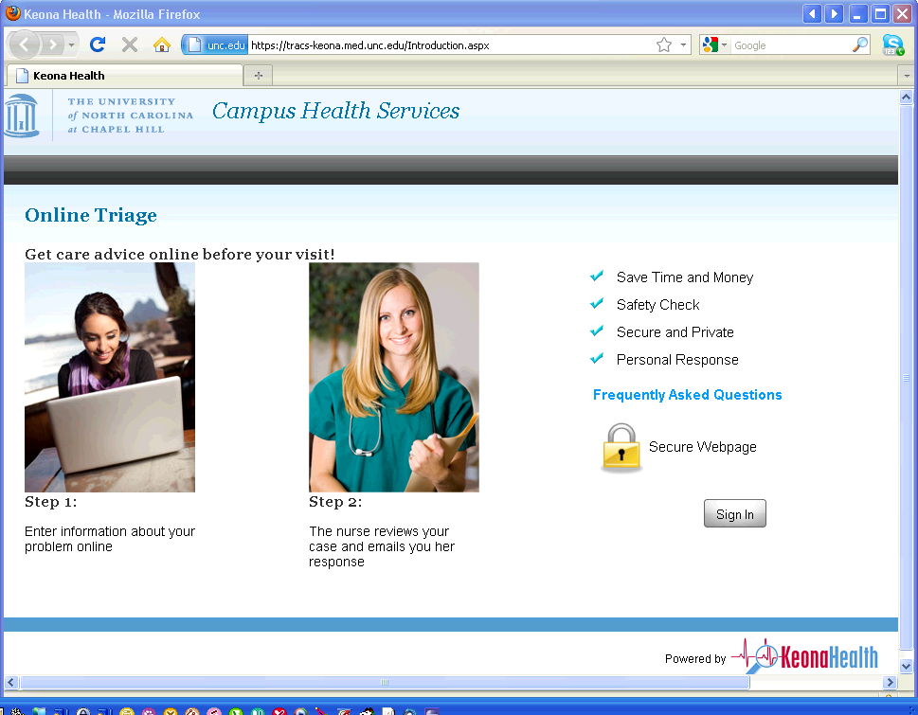
Operational Deployment – Online Triage

Slide 22
Key Components
Standard interfaces and data models
  Reference implementation of HL7/OMG DSS interface
  vMR data model
  Data mappers (e.g., for CCD → vMR)
Reference DSS knowledge management framework
  JBoss Drools and associated authoring/knowledge management tools
  Full-featured terminology support
  A “domain specific language” for intuitive knowledge authoring
  Knowledge repository and knowledge sharing service
DSS “wrappers” for other CDS engines

Slide 23
OpenCDS – Sample Topologies
DSS Client
OpenCDS DSS Interface
OpenCDS
Adapter X
OpenCDS
Drools Adapter
Apelon Distributed Terminology System (DTS)
OpenCDS Drools Engine
CDS Engine/Service X
(e.g., SEBASTIAN,
KMR-DDSS, CDSC)
OpenCDS Drools Knowledge Authoring Platform

Slide 24
OpenCDS – Tour and Demo
DSS Client
OpenCDS DSS Interface
OpenCDS
Drools Adapter
Apelon Distributed Terminology System (DTS)
OpenCDS Drools Engine
OpenCDS Drools Knowledge Authoring Platform

Slide 25
Terminology Management
External codes converted into internal OpenCDS concept(s) using terminology service
  E.g., ICD9CM 250.42 →
    Diabetes mellitus with renal manifestations
    Diabetes mellitus
    Endocrine disease
Separates terminology management from logic engineering
Uses Apelon DTS, but architecture supports use of other terminology services

Slide 26
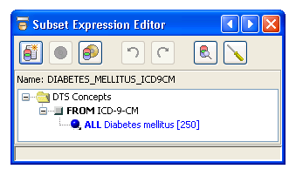
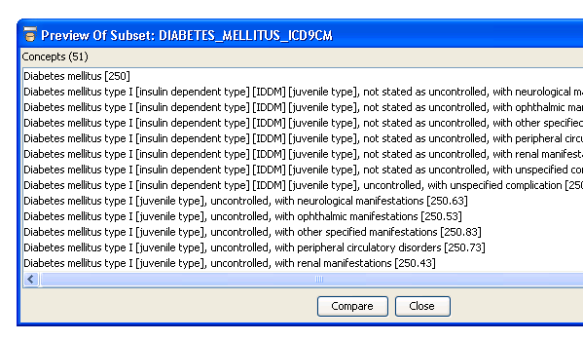
OpenCDS – Terminology Mgmt. with Apelon
Notes:
SCT 14May

Slide 27
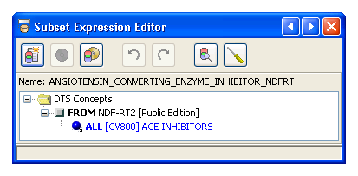
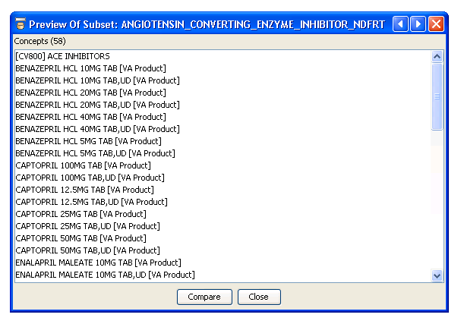
OpenCDS – Terminology Mgmt. with Apelon
Notes:
SCT 14May

Slide 28
Live Demo

Slide 29
Presentation Overview
Background
  CDS - definition, examples, evidence of effectiveness
Problem
  Need for scalable clinical decision support (CDS)
Potential Solution
  Standards-based, open-source CDS services
OpenCDS
Discussion
Notes:
SCT 14May

Slide 30
Key Benefits of Approach
Builds on robust open-source community and resources
Provides standard architectural framework for integrating various CDS knowledge resources
Supports full life cycle of knowledge authoring, testing, maintenance, and execution
Provides an open-source framework for collaboration and innovation in CDS
  Freely available under Apache 2.0 license
Notes:
SCT 14May

Slide 31
Key Challenges and Potential Solutions
Challenge | Potential solutions
Increased effort required to develop and support knowledge resources for use in multiple contexts | Balance generalizability with resource realities Spread knowledge development cost over multiple deployment settings
Limited content availability | Provide federal funding for content development Create an interoperable, standards-based market for such knowledge
Bottom line assessment: benefits >> challenges
Notes:
SCT 14May

Slide 32
Acknowledgements
Research support
  NHGRI K01 HG004645 (PI: K. Kawamoto)
  University of Utah Dept. of Biomedical Informatics
Numerous OpenCDS collaborators
Notes:
SCT 14May

Slide 33
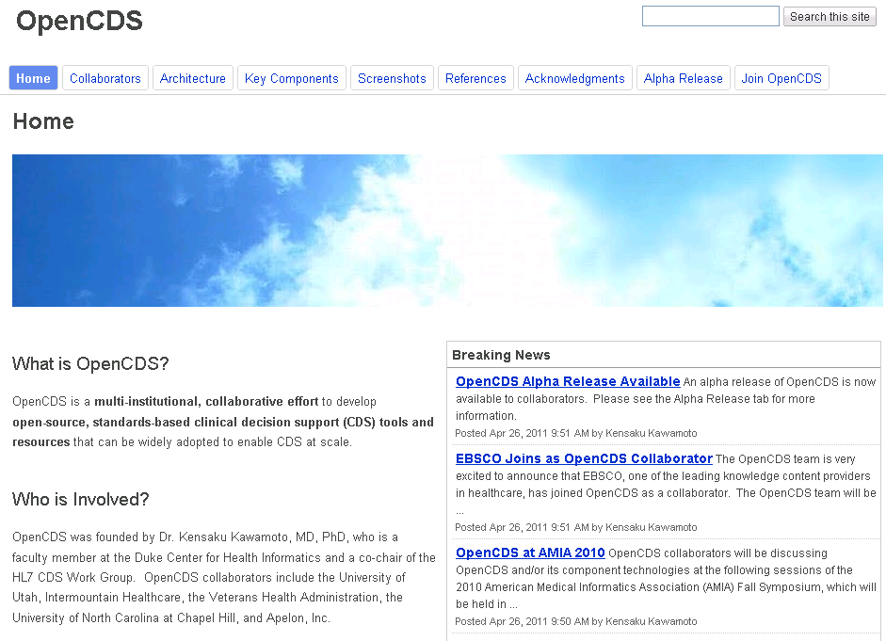
www.opencds.org
Notes:
SCT 14May

Slide 34
Thank You!
Kensaku Kawamoto, MD, PhD
kensaku.kawamoto@opencds.org
Notes:
SCT 14May

Slide 35
Backup Slides

Slide 36
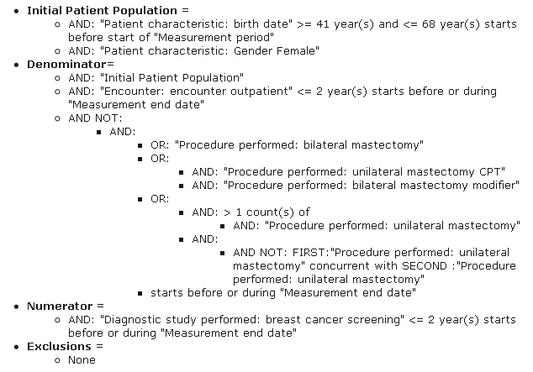
NQF Measure 31 for Meaningful Use

Slide 37
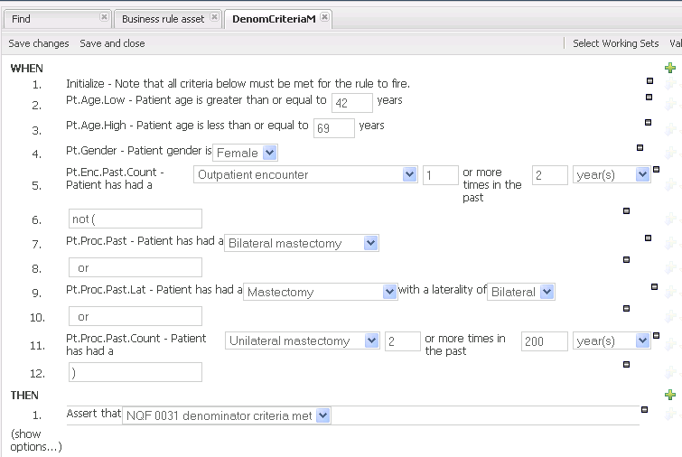
OpenCDS Implementation – Denom.

Slide 38
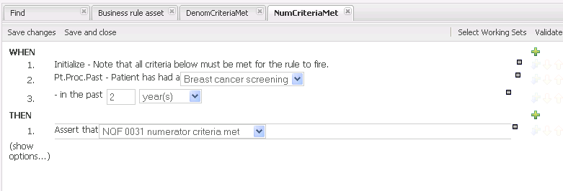
OpenCDS Implementation – Numerator

Slide 39
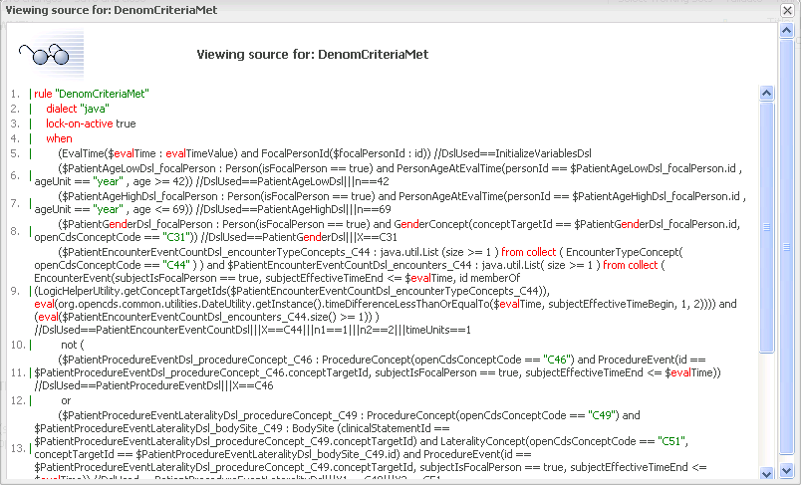
OpenCDS Implement. – Underlying Details

Slide 40
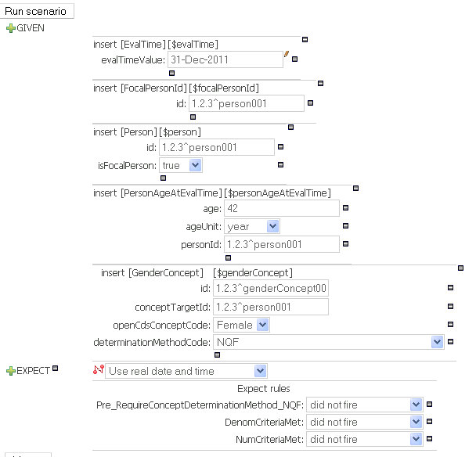
Testing Environment

Slide 41
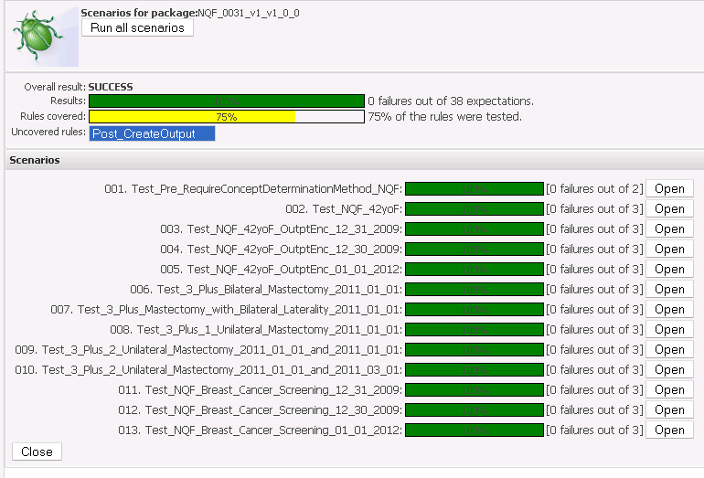
Batch Regression Testing

Slide 42
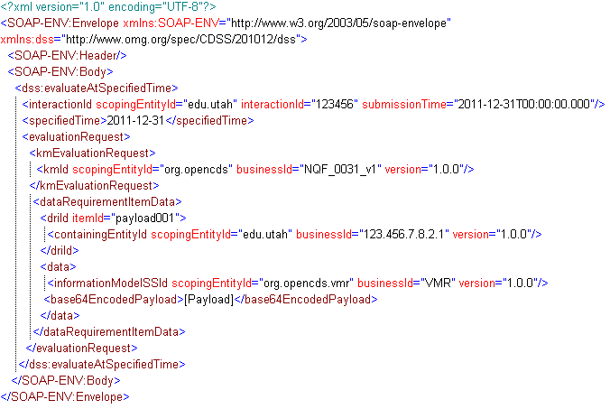
DSS Invocation - Wrapper

Slide 43
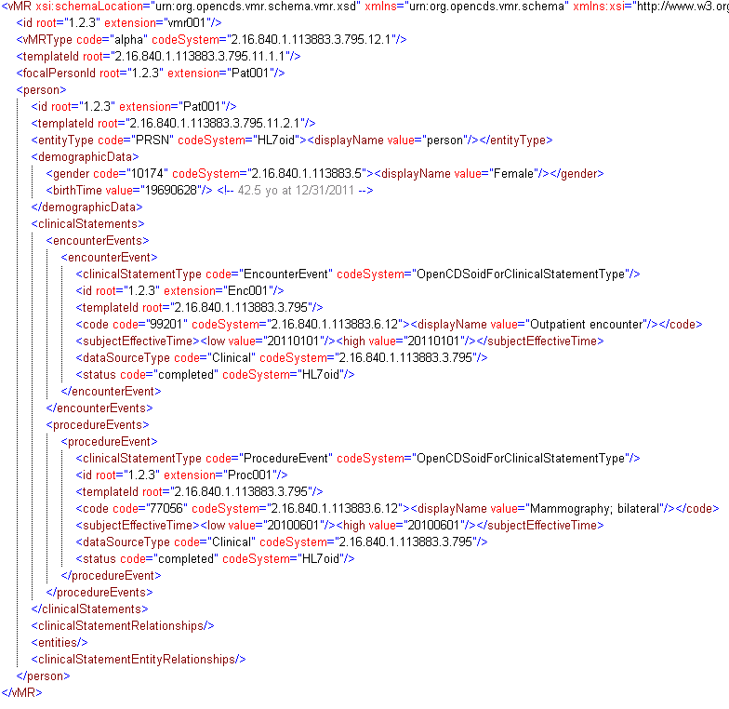
DSS Invocation - Payload

Slide 44
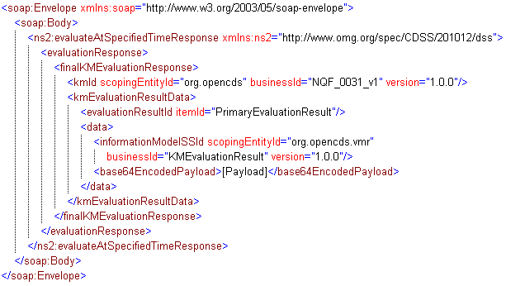
DSS Response - Wrapper

Slide 45
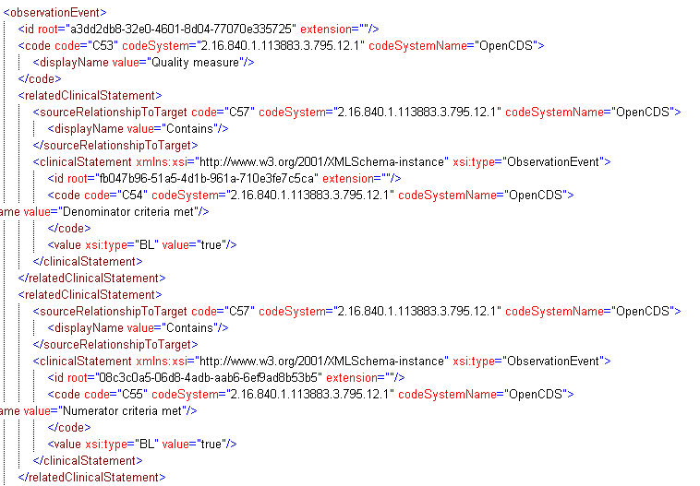
DSS Response - Payload

